Slide 1
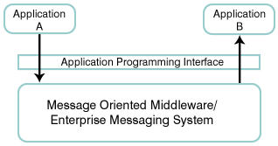
Java Message Service
The Java Message Service was developed by Sun Microsystems to provide a means for Java programs to access enterprise messaging systems.
Enterprise messaging systems, often known as message oriented middleware (MOM), provide a mechanism for integrating applications in a loosely coupled, flexible manner. They provide asynchronous delivery of data between applications on a store and forward basis; that is, the applications do not communicate directly with each other, but instead communicate with the MOM, which acts as an intermediary.
The MOM provides assured delivery of messages (or at least makes its best effort) and relieves application programmers from knowing the details of remote procedure calls (RPC) and networking/communications protocols.
Messaging flexibility
Application A communicates with Application B by sending a message through the MOM's application programming interface (API). The MOM routes the message to Application B, which may exist on a completely different computer; the MOM handles the network communications. If the network connection is not available, the MOM will store the message until the connection becomes available, and then forward it to Application B.
Another aspect of flexibility is that Application B may not even be executing when Application A sends its message. The MOM will hold the message until Application B begins execution and attempts to retrieve its messages. This also prevents Application A from blocking while it waits for Application B to receive the message.
Loose coupling
The real power of enterprise messaging systems lies in the loose coupling of the applications. Application A sends its messages indicating a particular destination, for example "order processing." Today, Application B provides order processing capabilities. But, in the future, Application B can be replaced with a different order-processing program, and Application A will be the same. It will continue to send its messages to "order processing" and the messages will continue to be processed. Likewise, Application A can be replaced, and as long as the replacement continued to send messages for "order processing,“ would not need to know there is a new application sending orders.

Slide 2
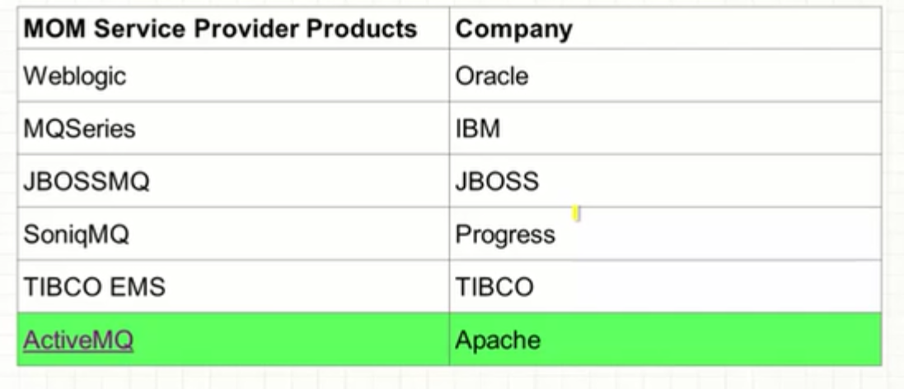
What is JMS?
A specification that describes a common way for Java programs to create, send, receive and read distributed enterprise messages
loosely coupled communication
Asynchronous messaging
Reliable delivery
A message is guaranteed to be delivered once and only once.
Outside the specification
Security services
Management services
JMS Clients
Java programs that send/receive messages
Messages
Administered Objects
preconfigured JMS objects created by an admin for the use of clients
ConnectionFactory, Destination (queue or topic)
JMS Provider
messaging system that implements JMS and administrative functionality
Notes:
A JMS Application is one or more JMS clients that exchange messages asynchronously
Asynchronous. A JMS provider can deliver messages to a client as they arrive; a client does not have to request messages in order to receive them.
Lower levels of reliability are available for applications that can afford to miss messages or to receive duplicate messages.
The JMS specification describes a set of programming interfaces that support distributed, enterprise messaging. An enterprise messaging systems enables independent distributed components or applications to interact through messages. These components, whether on the same system, the same network, or loosely connected through the Internet, use messaging to pass data and coordinate their respective functions.
exposing only the JMS APIs is to hide the details from the users that want a higher-level API and also to ensure portability among implementations.
As long as the vendor adheres to the JMS specification, a user shouldn't have to worry too much about how the implementation is constructed.
By itself, it provides no functionality: the API or interfaces are separate from the implementation This gives the benefit of describing in detail what the user view should be, while at the same time allowing vendors to implement the details however they want.
JMS is not an implementation of a message-oriented middleware.
security and management are not the concerns of the JMS spec

Slide 3
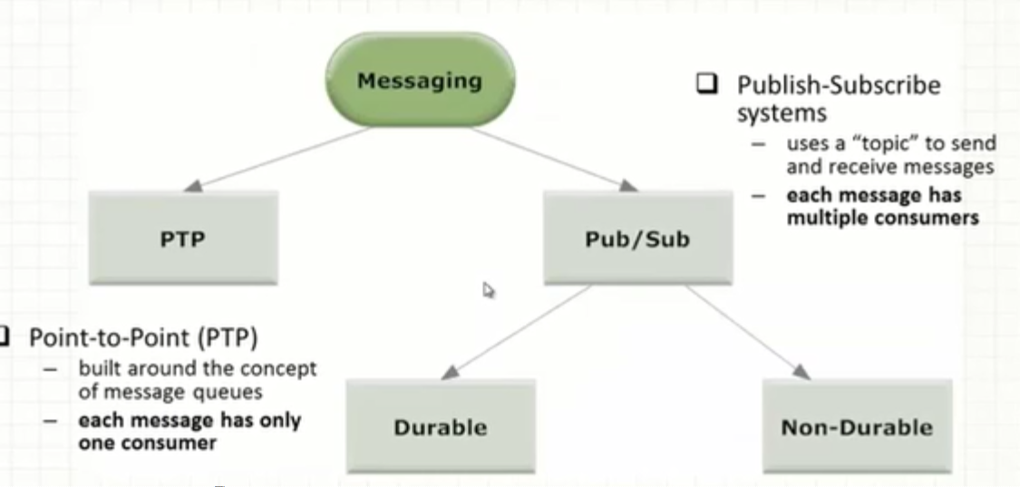
JMS Administration
Administrative
Tool
Bind
JNDI Namespace
Lookup
JMS Client
JMS Provider
Logical
Connection
JMS Messaging Domains
Point-to-Point (PTP)
built around the concept of message queues
each message has only one consumer
Publish-Subscribe systems
uses a “topic” to send and receive messages
each message has multiple consumers
Notes:
JNDI:java naming and directory service
administrative tool allows you to bind cf,dest to jndi. Clients lookup the admin objects in the jndi and then establish a logical connection to the same objects through provider
2 types of administrative objects: connection factory, destination
administrated objects are placed in a JNDI by admin.
a JMS client notes in its documentation the JMS admin objects it requires and how the JNDI names of these objects should be provided to it.
Connection factories are created by the server administrator and bound into the Java Naming and Directory Interface (JNDI) tree.
A JMS client uses JNDI to look up the ConnectionFactory and then uses the ConnectionFactory to establish a JMS connection.
A JMS Application is one or more JMS clients that exchange messages asynchronously.
JMS deals with two kinds of message domains. -
Point-to-Point (PTP) are built around the concept of message queues.
Publish-Subscribe systems use a “topic” to send and receive messages.
Supports messages containing Java objects and XML pages.

Slide 4
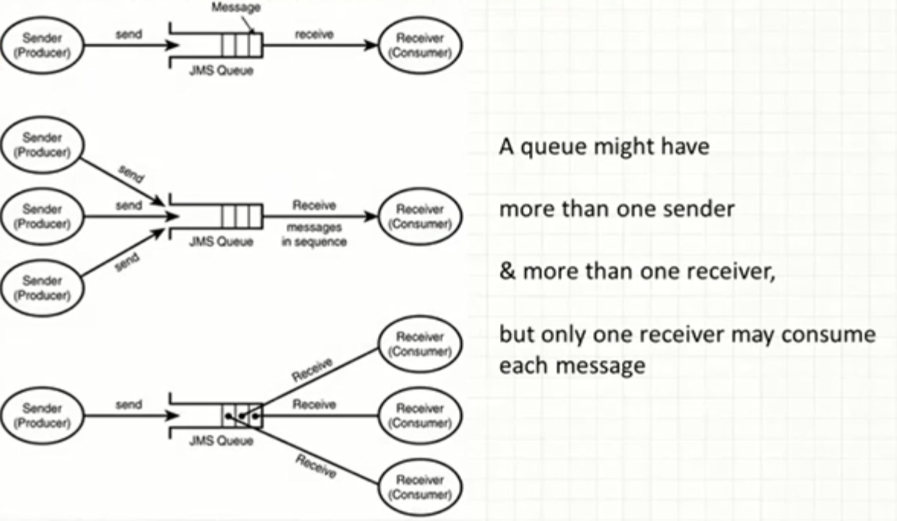
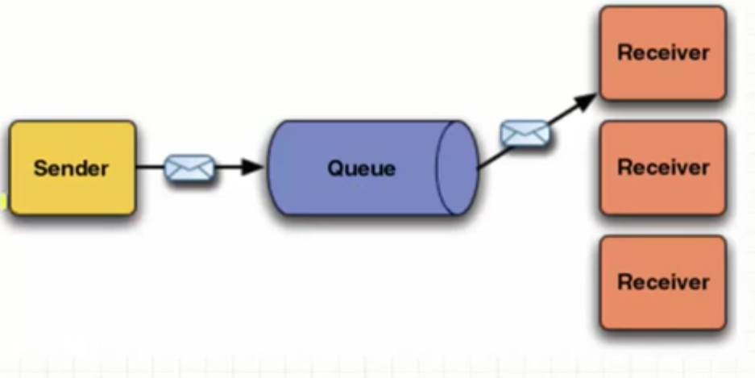
Point-to-Point Messaging
Msg
Msg
consumes
Client1
Client2
Queue
sends
acknowledges
One Consumer
a sender and a receiver have no timing dependencies. the receiver can fetch the msg whether or not it was running when client sent the msg receiver acknowledges
Notes:
1 consumer
a sender and a receiver have no timing dependencies. the receiver can fetch the mesg whether or not it was running when client sent the msg
receiver acknowledges

Slide 5
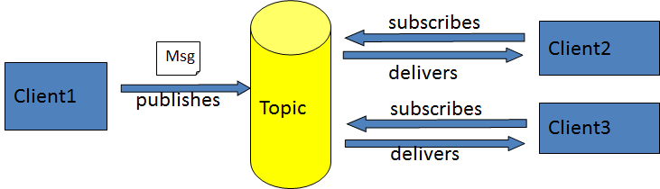
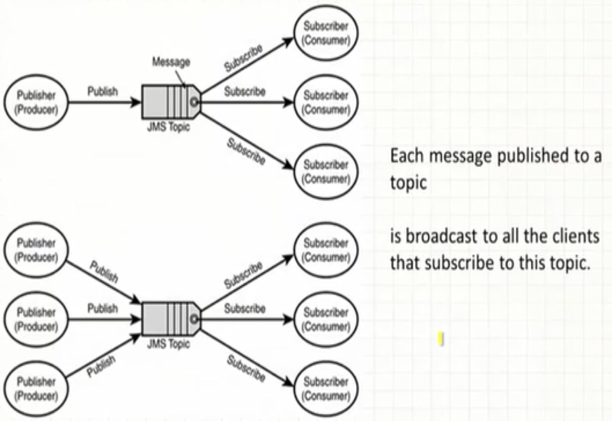
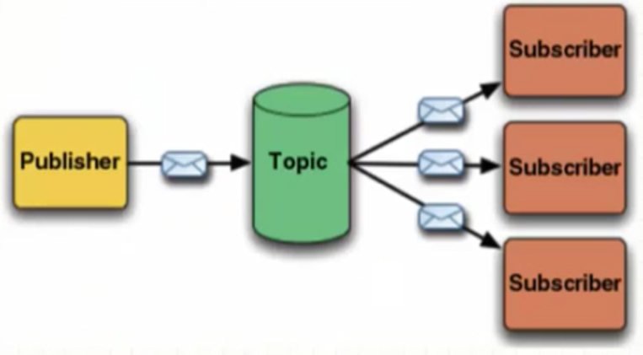
Publish/Subscribe Messaging
Multiple Consumers
publishers and subscribers have timing dependency. a client can consume only msgs published after its subscription and must continue to be active to consume msgs
( exception durable subscription)
Notes:
multiple consumers
publishers and subscribers have timing dependency. a client can consume only msgs published after its subscription and must continue to be active to consume msgs
( exception durable subscription)

Slide 6
Message Consumptions
Synchronously
A subscriber or a receiver explicitly fetches the message from the destination by calling the receive method.
The receive method can block until a message arrives or can time out if a message does not arrive within a specified time limit.
Asynchronously
A client can register a message listener with a consumer.
Whenever a message arrives at the destination, the JMS provider delivers the message by calling the listener's onMessage() method.
JMS API Programming Model
JMS Interfaces:
connectionfactory: administrative object used by client to create a connection
connection: an active connection for JMS provider
destination: administrative object that encapsulates the identity of a message destination
session: a single-threaded context for sending/receiving message
Message producer: an object created by a session that is used for sending msg to a destination
Message consumer: similar
Connection
Factory
creates
Connection
Message
Producer
creates
creates
Message
Consumer
Session
sends to
creates
Receives from
Destination
Msg
Destination
Notes:
A message listener is similar to an event listener

Slide 7
JMS Client Example
Consumer Sample (Synchronous)
Setup connection and create a session
Creating consumer
MessageConsumer consumer=session.createConsumer(dest1);
Start receiving messages
connection.start();
Message m=consumer.receive();
Setting up a connection and creating a session
InitialContext jndiContext=new InitialContext();
//look up for the connection factory
ConnectionFactory cf=jndiContext.lookup(connectionfactoryname);
//create a connection
Connection connection=cf.createConnection();
//create a session
Session session=connection.createSession(false,Session.AUTO_ACKNOWLEDGE);
//create a destination object
Destination dest1=(Queue) jndiContext.lookup(“/jms/myQueue”); //for PointToPoint
Destination dest2=(Topic)jndiContext.lookup(“/jms/myTopic”); //for publish-subscribe
Consumer Sample (Asynchronous)
Setup the connection, create a session
Create consumer
Registering the listener
MessageListener listener=new myListener();
consumer.setMessageListener(listener);
myListener should have onMessage()
public void onMessage(Message msg){
//read the massage and do computation
}
Producer Sample
Setup connection and create a session
Creating producer
MessageProducer producer=session.createProducer(dest1);
Send a message
Message m=session.createTextMessage();
m.setText(“just another message”);
producer.send(m);
Closing the connection
connection.close();
Notes:
transacted session
connection.createSession(true,0);
AUTO_ACK: when client succesfully returned froma call to receive or when messagelistener returned successfully
Client_ACK: a client acks a mesg by calling the message’s acknowledge() method ( consume 10 ack 5th, you acked for all 10)
DUPS_ACK:dups are permitted, lazy ack (??)

Slide 8
Major components of JMS system
A). JMSServer: JMS server is an environment-related configuration entity that acts as management container for JMS queue and topic resources defined within JMS modules that are targeted to specific that JMS server. B). JMS Modules: JMS modules contain configuration resources, such as standalone queue and topic destinations, distributed destinations, and connection factories. In WebLogic Server these Configurations can be seen inside “<DOMAIN_HOME>/config/jms” Directory. C). JMS Client: A JMS is a JMS applications that either produce messages to destinations or consume messages from destinations. D). JNDI : Java Naming And Directory interface,It is a Java API for a directory service that allows Java software clients to discover and look up data and objects via a name. E). Persistent Store: It can be a UserDefined Persistent Store or a Default Persistent store. It is used for storing the Data (Messages).
Here we are going to see how we can configure WebLogic JMS Server, JMS Modules (Queue/ConnectionFactory) how to Target them and then How to test it using a Simpel Java Programs.

Slide 9
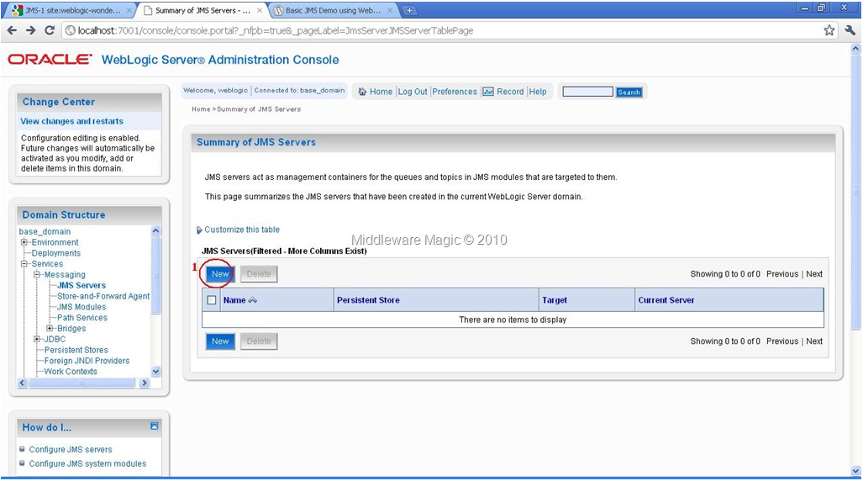
Here we are going to see how we can configure WebLogic JMS Server, JMS Modules (Queue/ConnectionFactory) how to Target them and then How to test it using a Simple Java Programs.
Step1). Start your WebLogic Server an Login to the AdminConsole.
Step2). Create a JMS Server…
Creating JMS Server

Slide 10
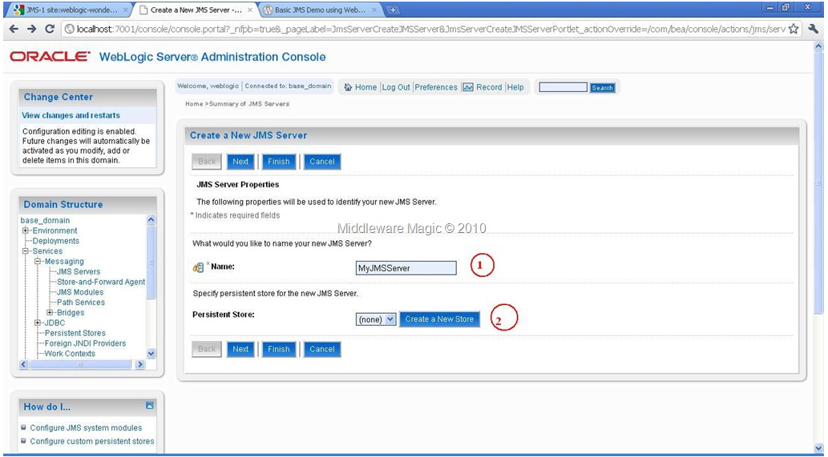
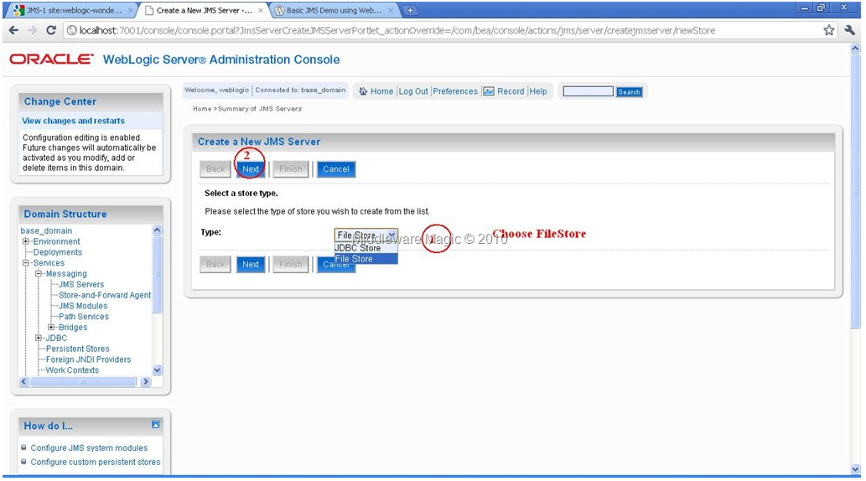
Creating JMS Server-2
Selecting JMS Server Store Type

Slide 11
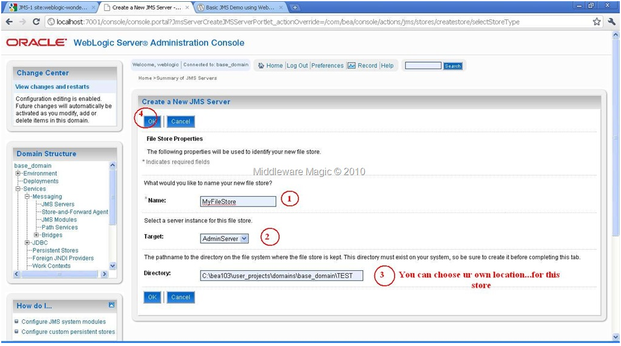
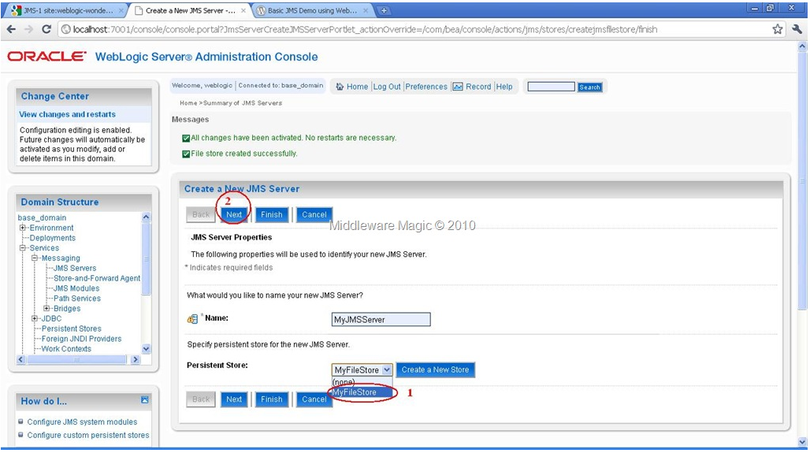
Configuring JMS Store
Choosing JMS Store for JMSSErver

Slide 12
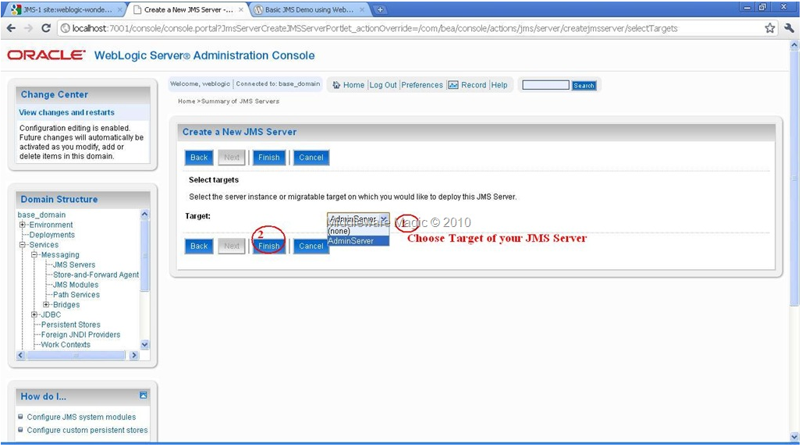
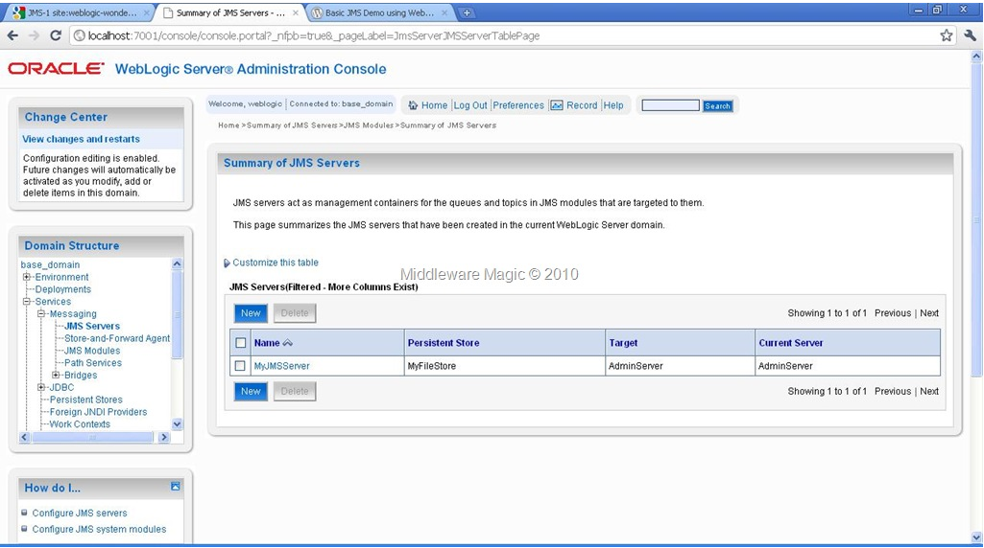
Targeting to the JMS Server
Activating the JMS Server Configuration

Slide 13
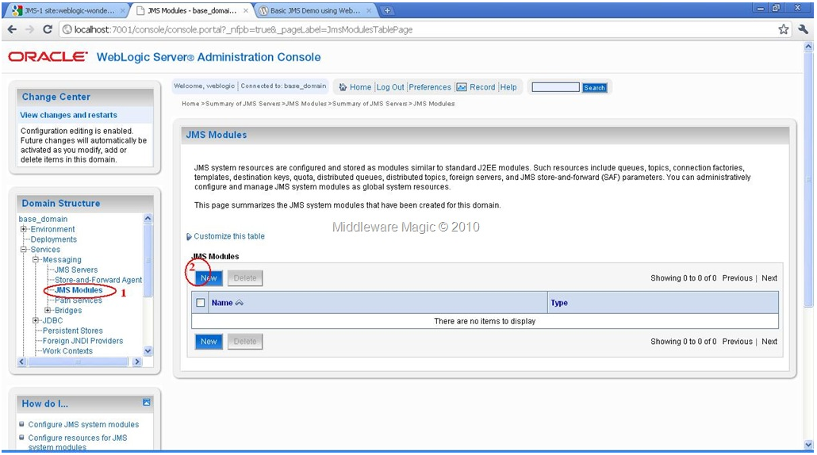
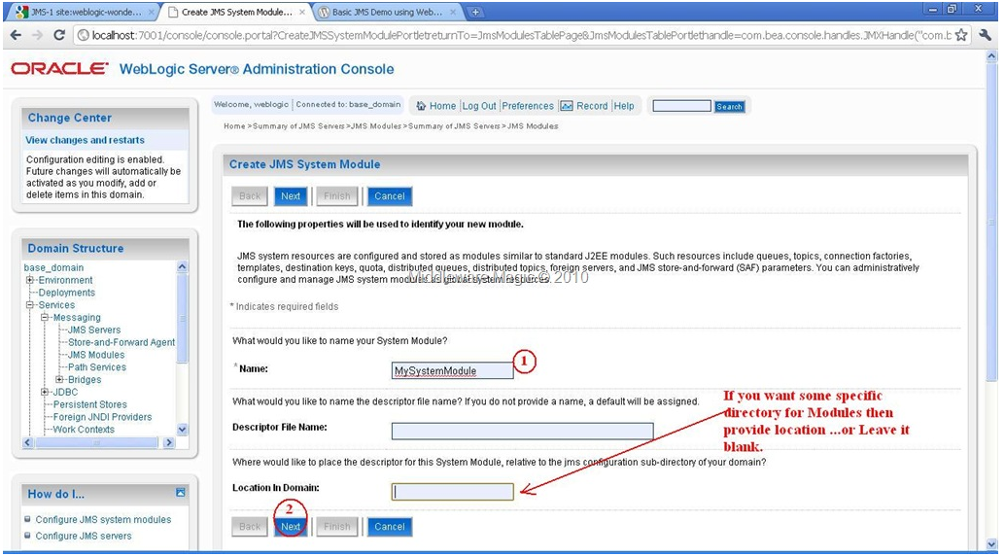
Step3). Configuring JMS Module:
Creating JMS Module
Entering JMS Module Name

Slide 14
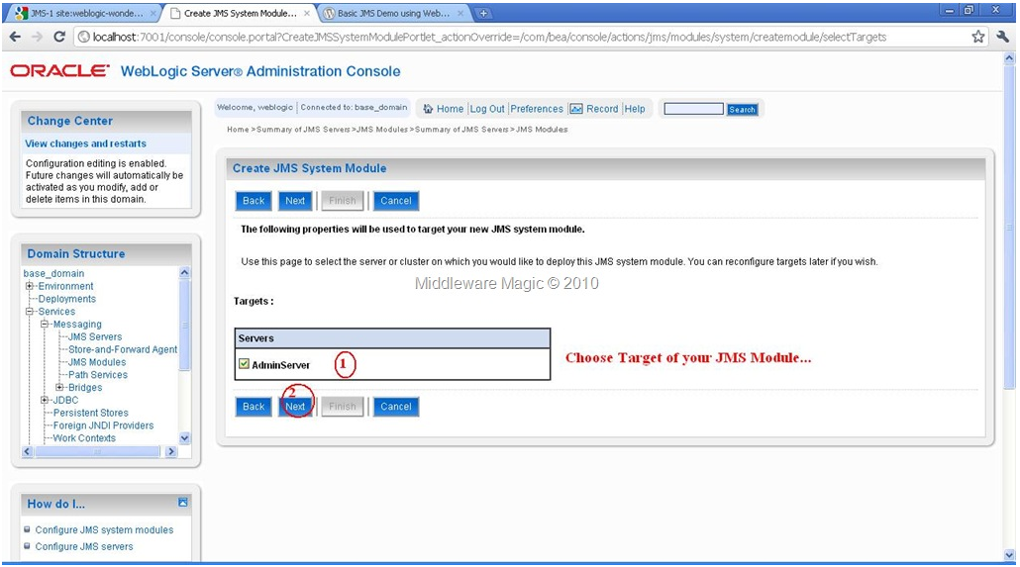
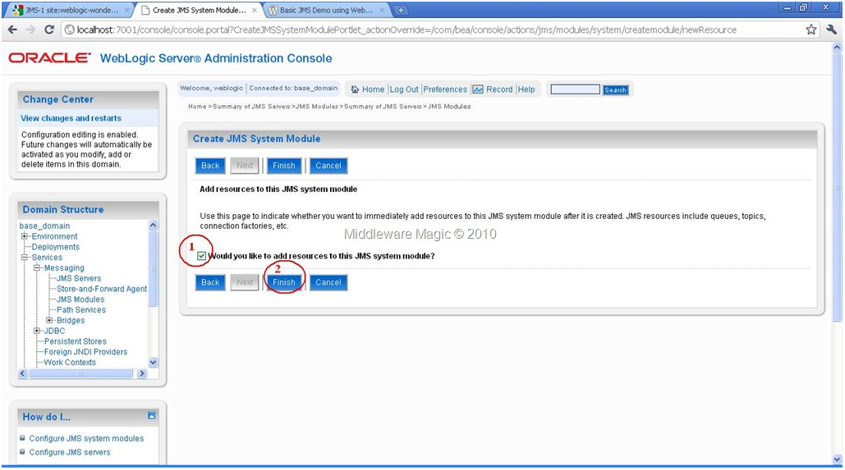
Targetting JMS Module
Finishing the Module Creation

Slide 15
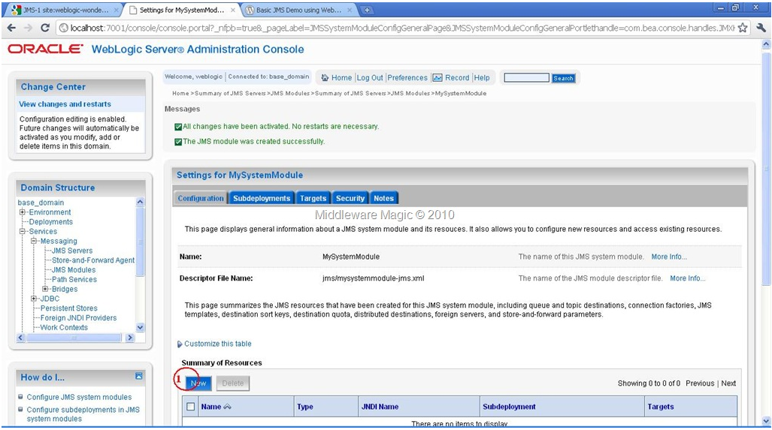
Step4). Creating Connection Factory:

Slide 16
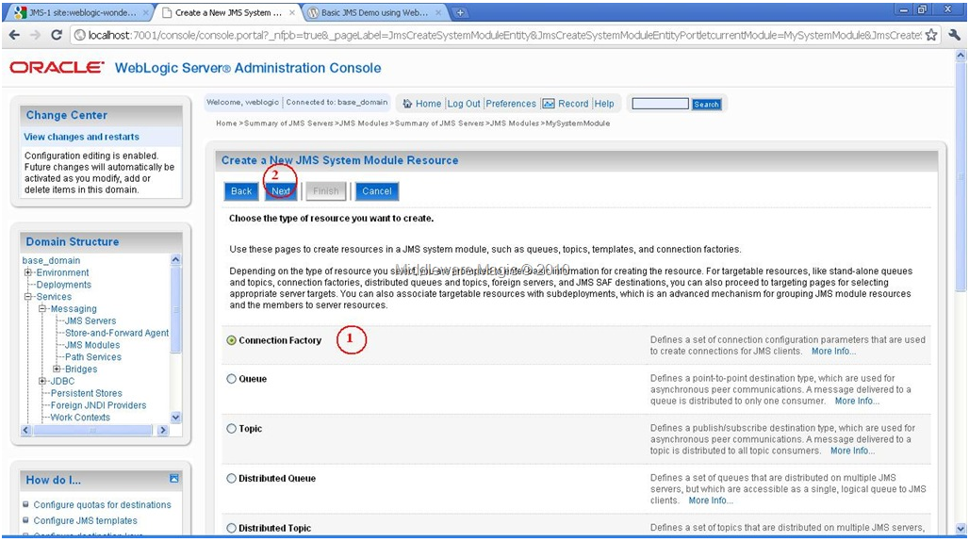
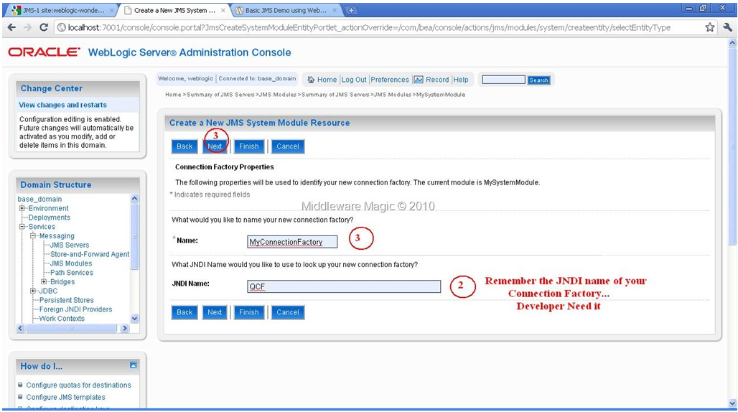
Selecting JMS Module to be Created
Providing Name/JNDIName to Connection Factory

Slide 17
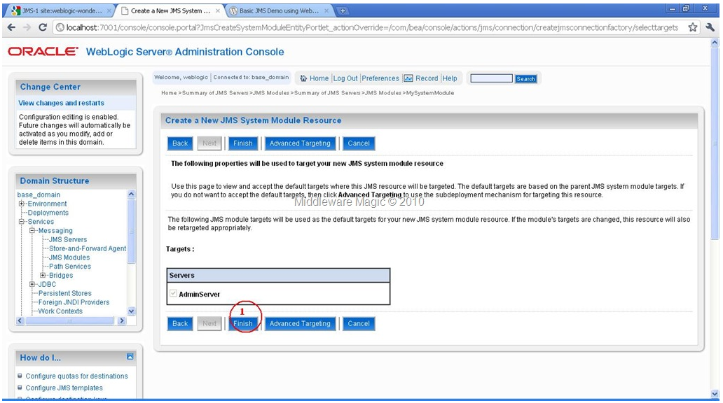
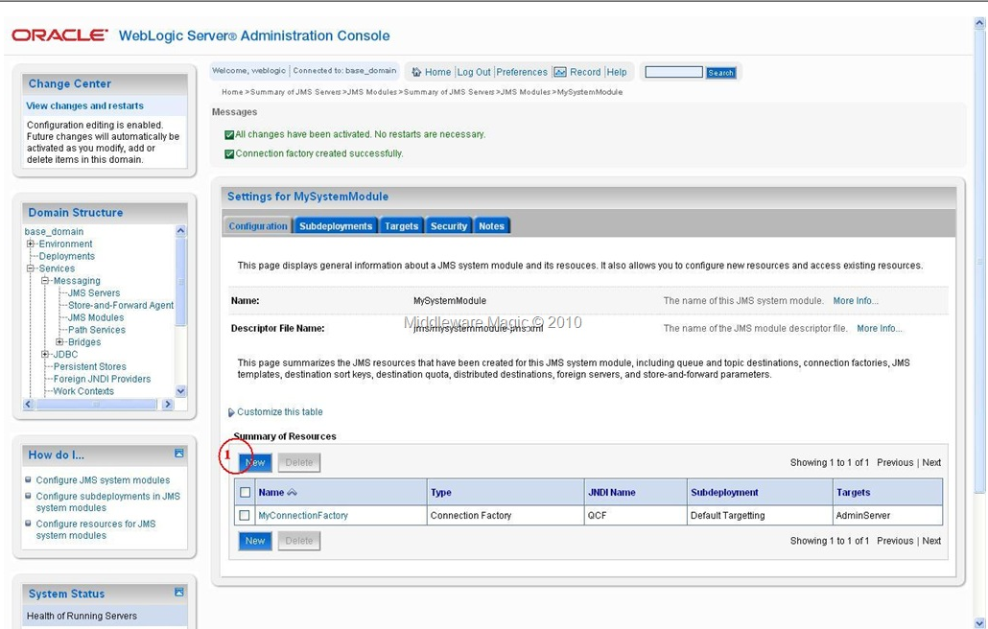
Targeting the ConnectionFactory
Step5).Creating JMS Queue:
Selecting JMSQueue to be Created

Slide 18
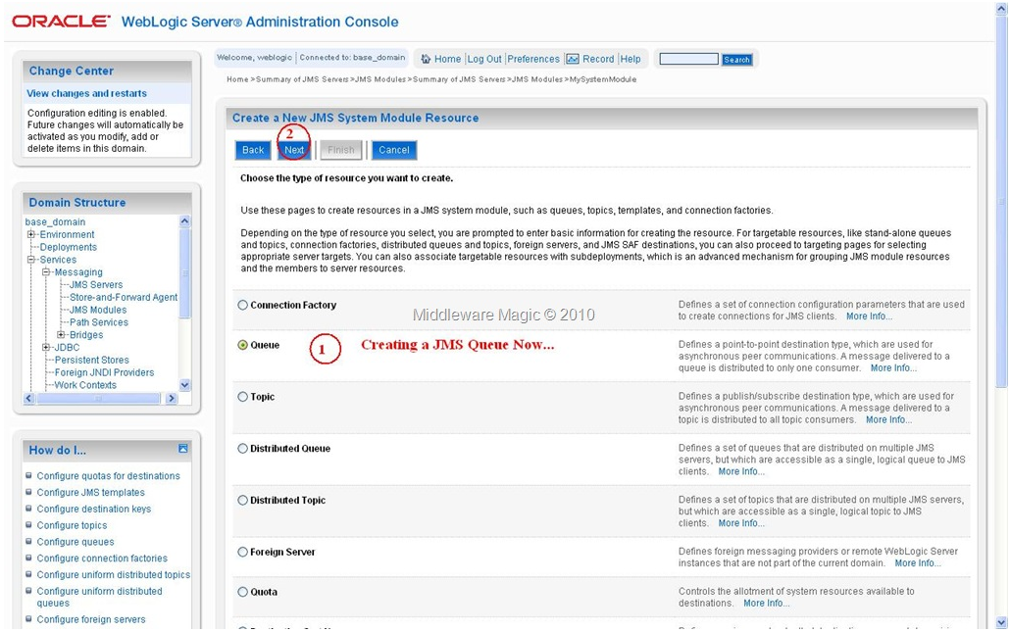
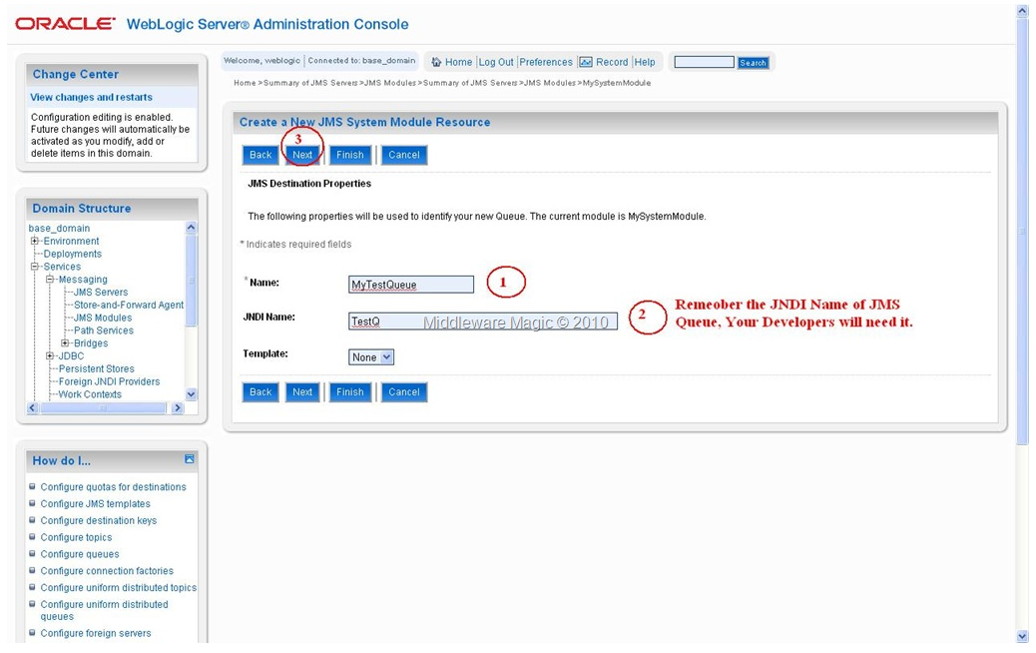
Queue Selection
Assigning Name/JNDIName to Queue

Slide 19
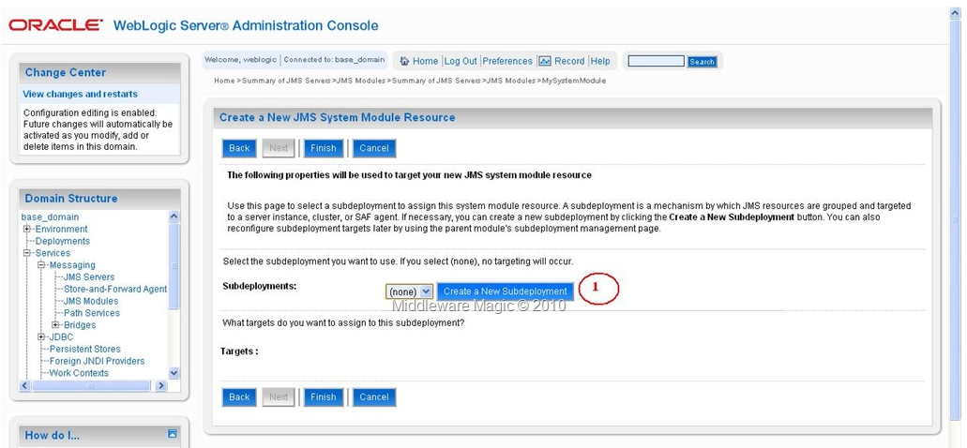
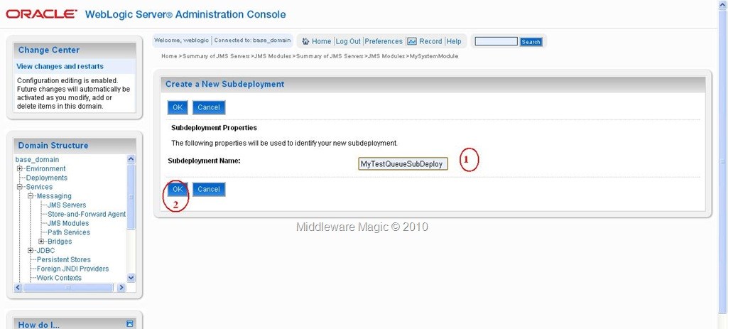
Creating SubDeployment
Assigning Name to the SubDeployment

Slide 20
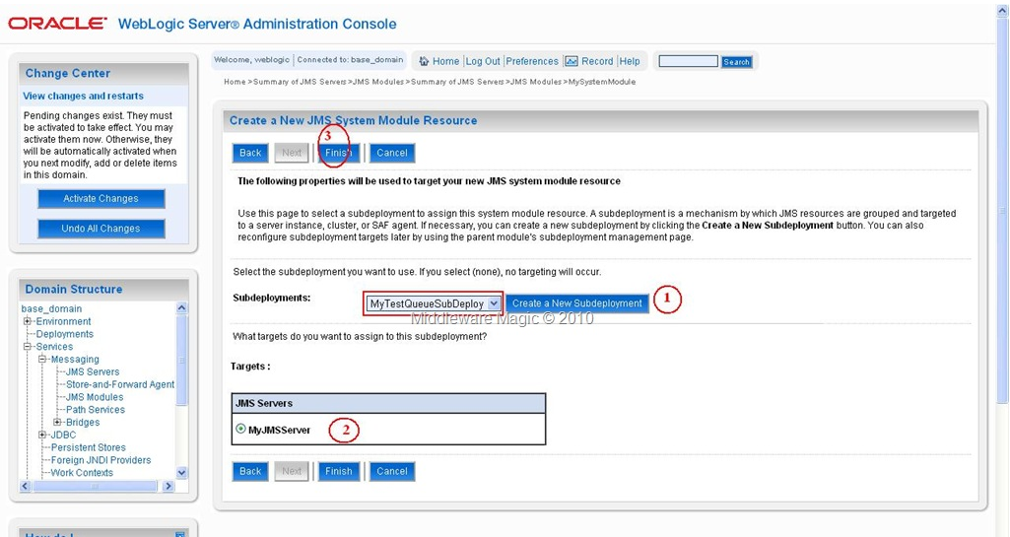
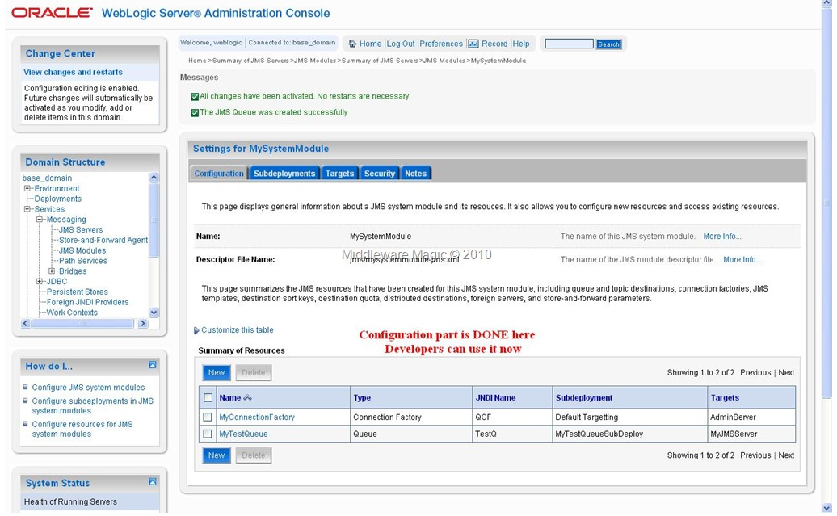
Targeting the JMS Queue
Activating the Final Changes

Slide 21
Now Write a Simple Java Program to send the Messages to this JMS Queue…like following:
Please set the classpath for the below jars
C:\devtools\Oracle\Middleware\wlserver_10.3\server\lib\wljmsclient.jar
C:\BALA POS\JMS\jndi-1.2.1.jar\jndi-1.2.1.jar
Step7). Now run the “setWLSEnv.cmd” and then compile and Run the QueueSend program.
Java QueueSend t3://localhost:7001
Step8). Now Login to AdminConsole to check that the Message is arrived in the JMS Queue or Not?
home—> Services–> Messaging–> JMS Modules–> MySystemModule–>MyQueue–> Monitoring–> MySystemModule –> MyQueue (Check the CheckBox)–> Show Messages(Click This Button)

Slide 22
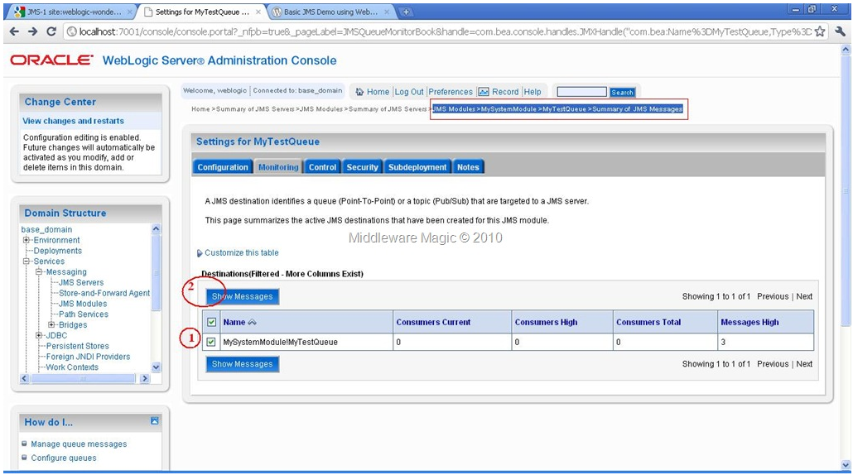
Monitoring JMS Queue Message In AdminConsole
Step9). Now write the following “QueueReceive.java” program to read JMS Messages from the JMS Queue.
Step10). Now compile and run the QueueRecieve.java program to read the messages from WebLogic JMS Queue.
java QueueReceive t3://localhost:7001

Slide 23
TOPIC
Step3). Now we need to create a JMS Module.
Step4). Now we need to create a ConnectionFactory.
Step5). Creating a WebLogic Topic.
Step6). Create a Directory somewhere in your file system like: “C:\WebLogic_Topic_Demo” to write the TopicSend and TopicReceive programs.
Step7). Write the “TopicSend.java” program as following inside “C:\WebLogic_Topic_Demo”
Step8). Write the “TopicReceive.java” program as following inside “C:\WebLogic_Topic_Demo” to receive messages from the WebLogic Topic

Slide 24
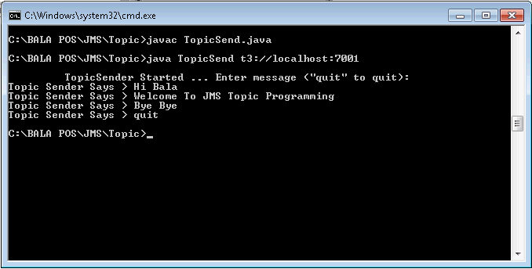
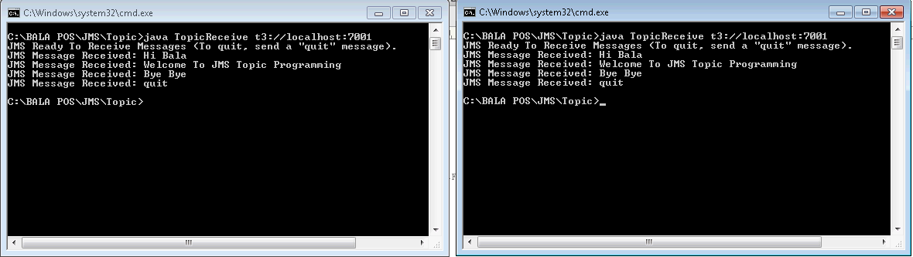
Step9). Open 3 – Command Windows and run “setWLSEn.cmd” in all the three Command Windows to set the Environment (PATH & CLASSPATH). Then compile the “TopicSend.java” and “TopicReceive.java” programs.
Step10). Start the “TopicReceive.java” program in two Command Windows like following : java TopicReceive t3:/localhost:7001
Step11). Now start the “TopicSend.java” program to send some messages to the WebLogic Topic….As soon as u send message you will see that the Receivers started getting those messages…(One to Many Communication….one sender multiple receiver Which is called as Publish-Subscribe Messaging…. TOPIC)

Slide 25
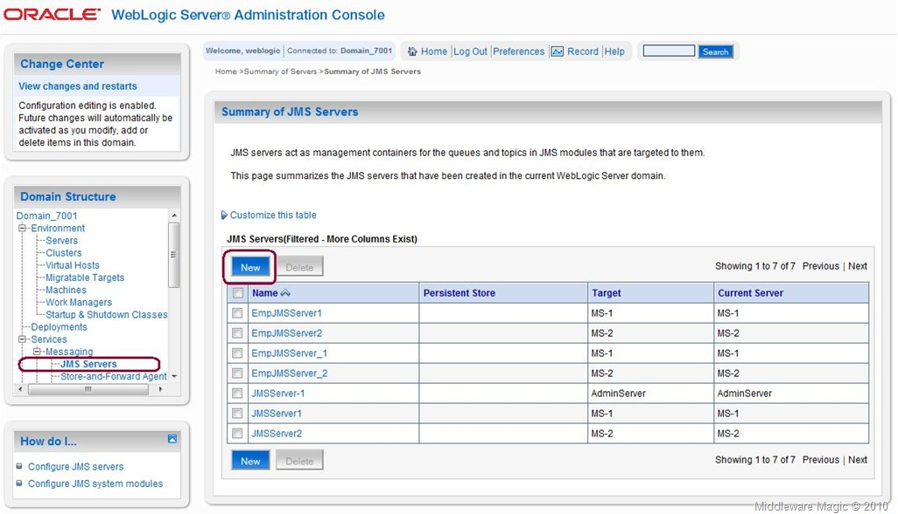
JMS Demo using WebLogic Durable Subscriber Topic
Durable subscriptions means that weblogic server will store the messages in a persistent store (i.e a file-store or a JDBC-store) until those messages are delivered to the subscribers/listener. This technique helps weblogic server to make sure that the messages get delivered even if those subscribers/listeners are not active at the time that the message is getting delivered.
Steps to Configure Durable Subscribers Topic:
1. Start your WebLogic Server an Login to the Admin Console.
2. Create a JMS Server and File store.
Creating JMS Server

Slide 26
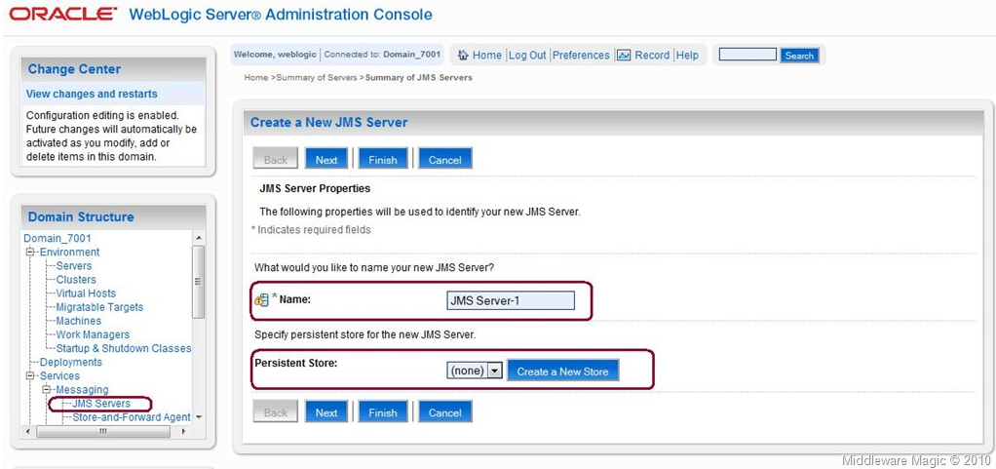
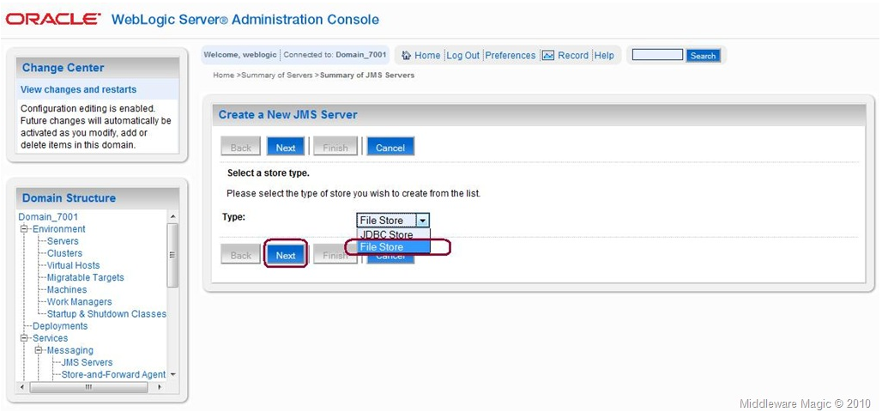
Creating JMS Server-1
Selecting JMS Server Store Type

Slide 27
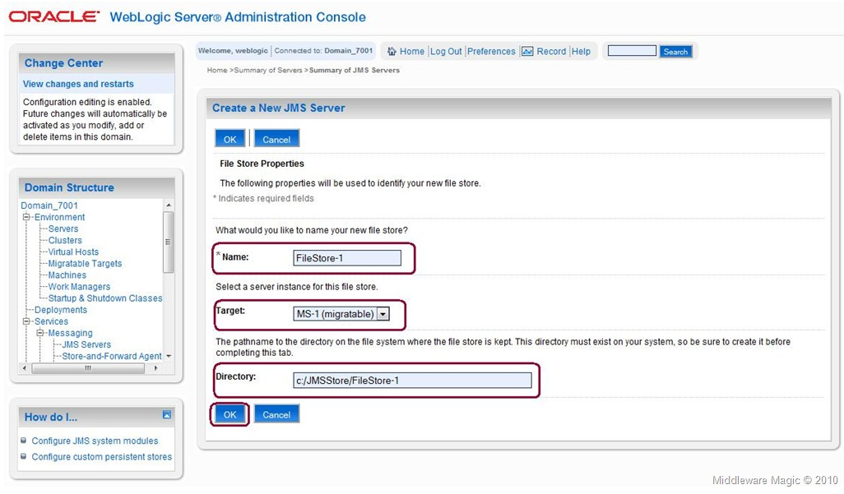
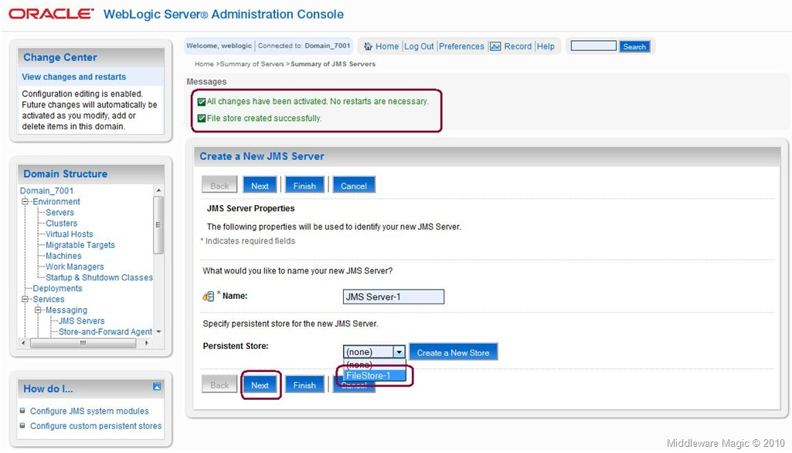
Configuring JMS Store
Choosing JMS Store for JMS Server

Slide 28
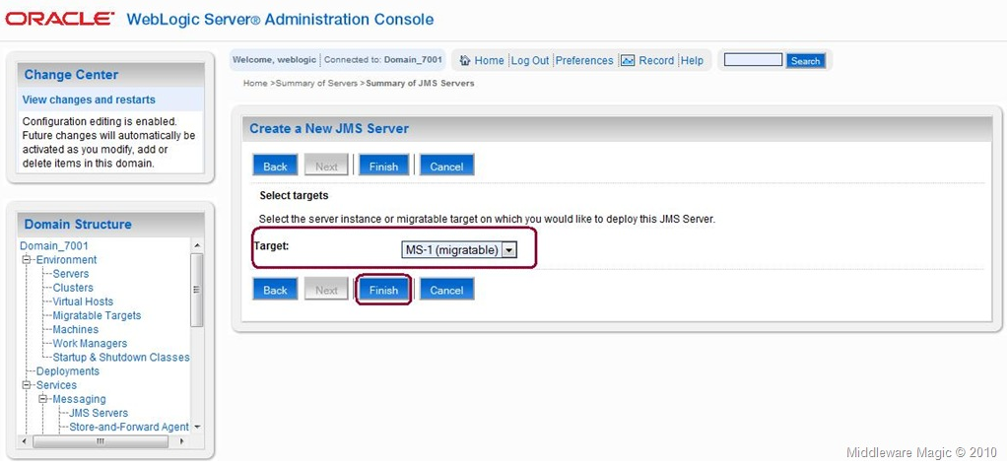
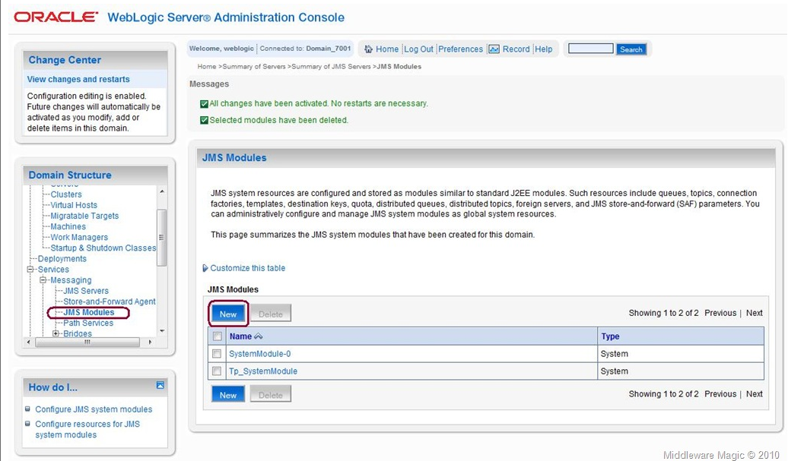
Targeting to the JMS Server
3. Configuring JMS Module

Slide 29
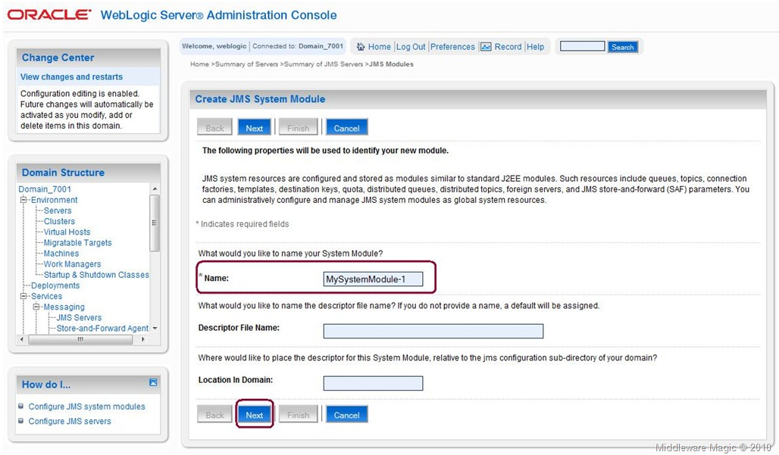
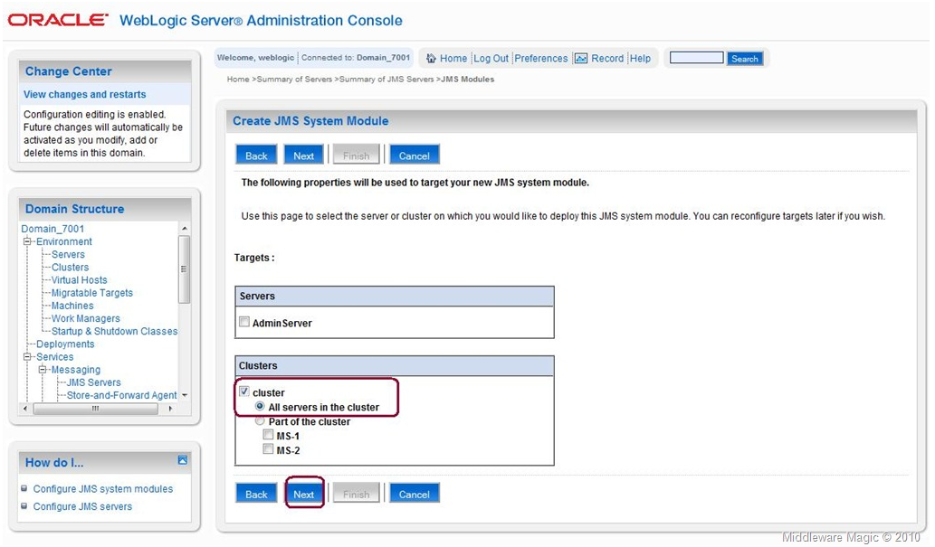
Entering JMS Module Name
Targeting JMS Module

Slide 30
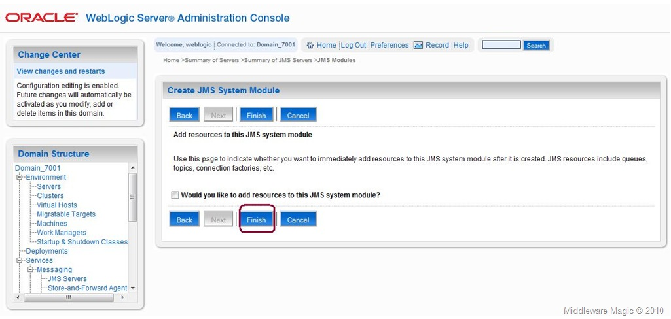
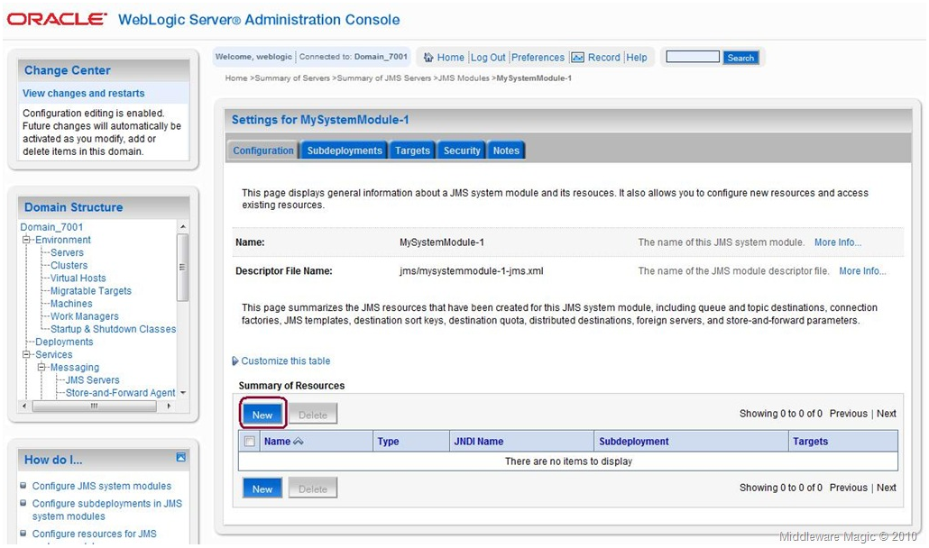
Finishing the Module Creation
4. Creating Connection Factory
Creating JMS Connection Factory

Slide 31
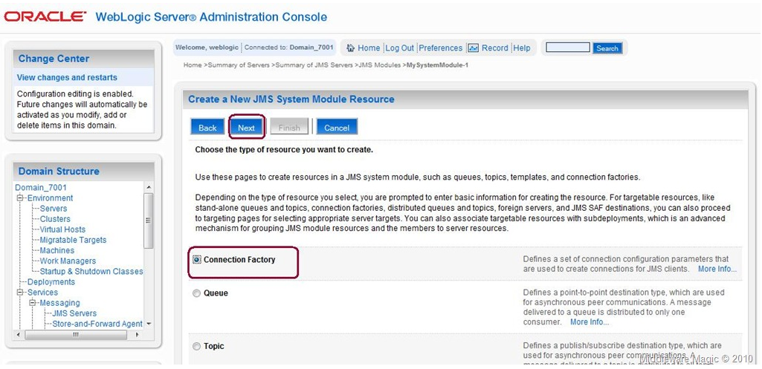
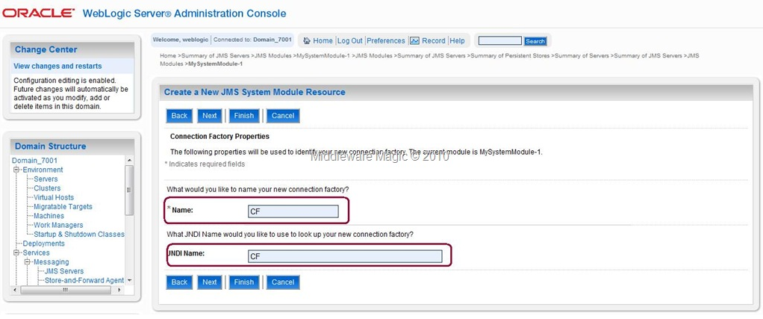
Selecting Connection Factory to be Created
Creating the Connection Factory

Slide 32
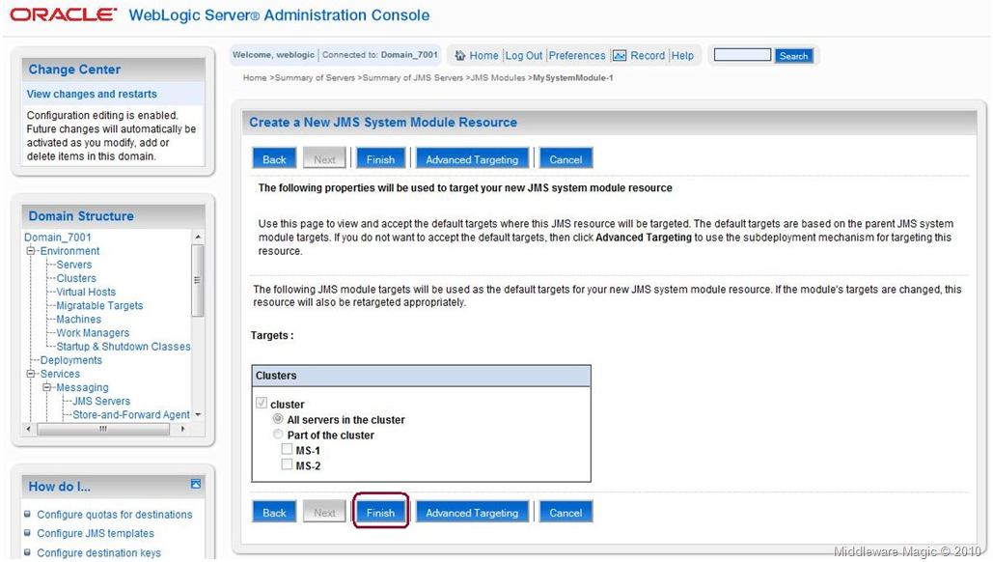
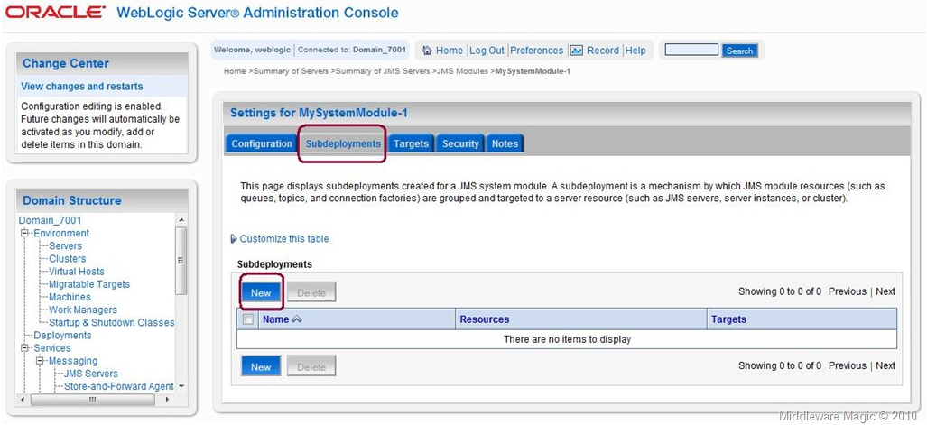
5. Creating Sub-Deployment
Targeting the Connection Factory
Creating Sub-Deployment

Slide 33
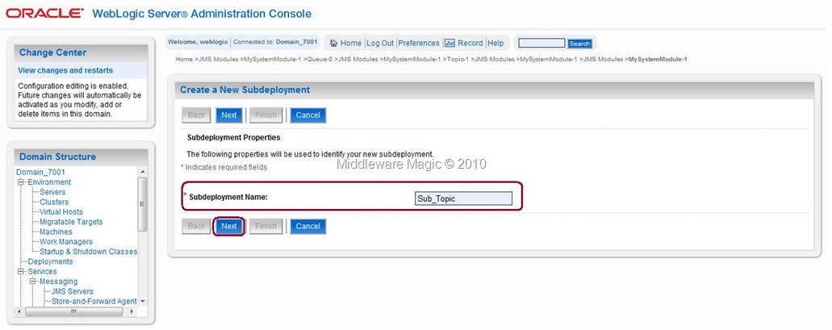
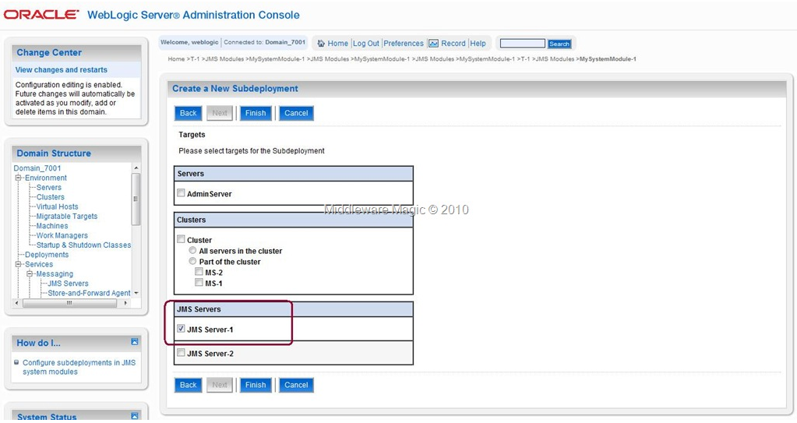
Creating the Sub Deployment
Targeting the Sub-Deployment

Slide 34


6. Creating a Topic
Creating Topic
Selecting Topic

Slide 35


Providing Name/JNDIName to the Topic
Targeting the Distributed Queue with the Sub-Topic

Slide 36


7. Creating Durable Subscriptions
Selecting T-1
Creating Durable subscriber

Slide 37

Providing Subscription Name / Client ID for the Durable Subscriber

